Slide 1
Unusual foreign body ingestion in an adult a case report
Dr. Chandana Allu
First Year P.G. : MS ENT
Government ENT Hospital

Slide 2
introduction
Foreign bodies in oesophagus are considered to be a serious clinical condition both in adults and children due to the possible complications (oesophageal perforation, mediastinitis, fistulization, airway obstruction) with a high morbidity and mortality .
Therefore a rapid and accurate diagnosis together with subsequent treatment are necessary.
A very unusual foreign body is described herein , namely one half of a metal tongue cleaner ,treated at Government ENT Hospital and Osmania General Hospital.
The peculiarity of this case concerns the size ,shape and location of the foreign body, the age of the patient and the lack of any adult risk factors.

Slide 3

CASE REPORT
A 47 year-old male presented to casualty of Government ENT Hospital with history of accidental ingestion of broken half of a metal tongue cleaner one hour ago.
The patient complained of pain in the epigastric region. He had no other complaints at presentation.

Slide 4

ON EXAMINATION
The patient was in moderate distress, but hemodynamically stable and afebrile.
There was diffuse pain in the epigastric region ,the abdomen was soft without any tenderness
There was no palpable mass.
The rest of the examination was within normal limits

Slide 5
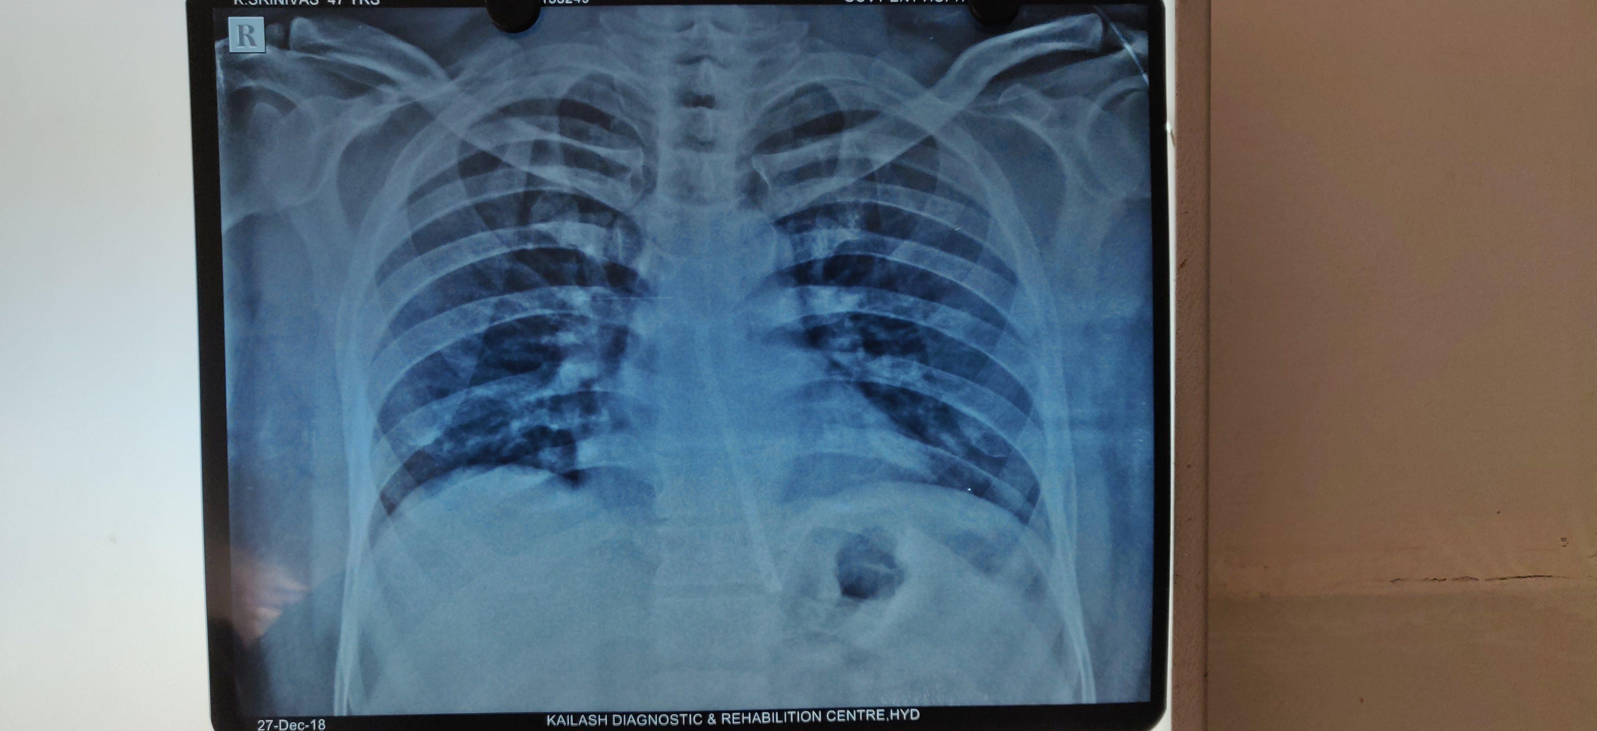
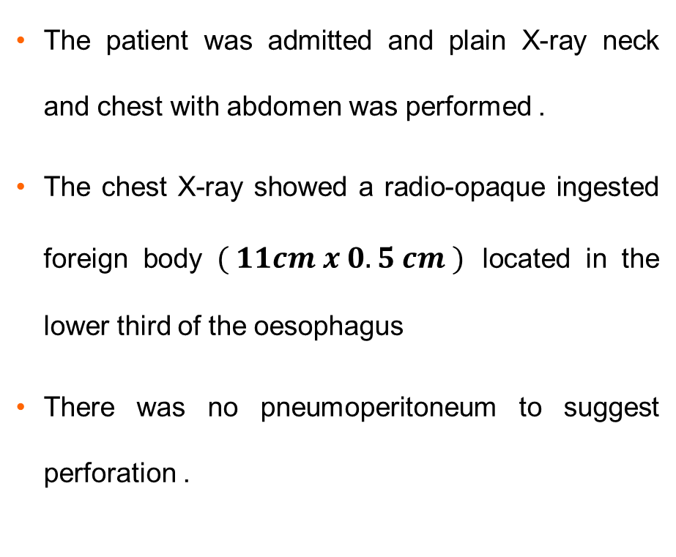
investigations
The patient was admitted and plain X-ray neck and chest with abdomen was performed .
The chest X-ray showed a radio-opaque ingested foreign body $( 11cm x 0.5 cm )$ located in the lower third of the oesophagus
There was no pneumoperitoneum to suggest perforation .

Slide 6
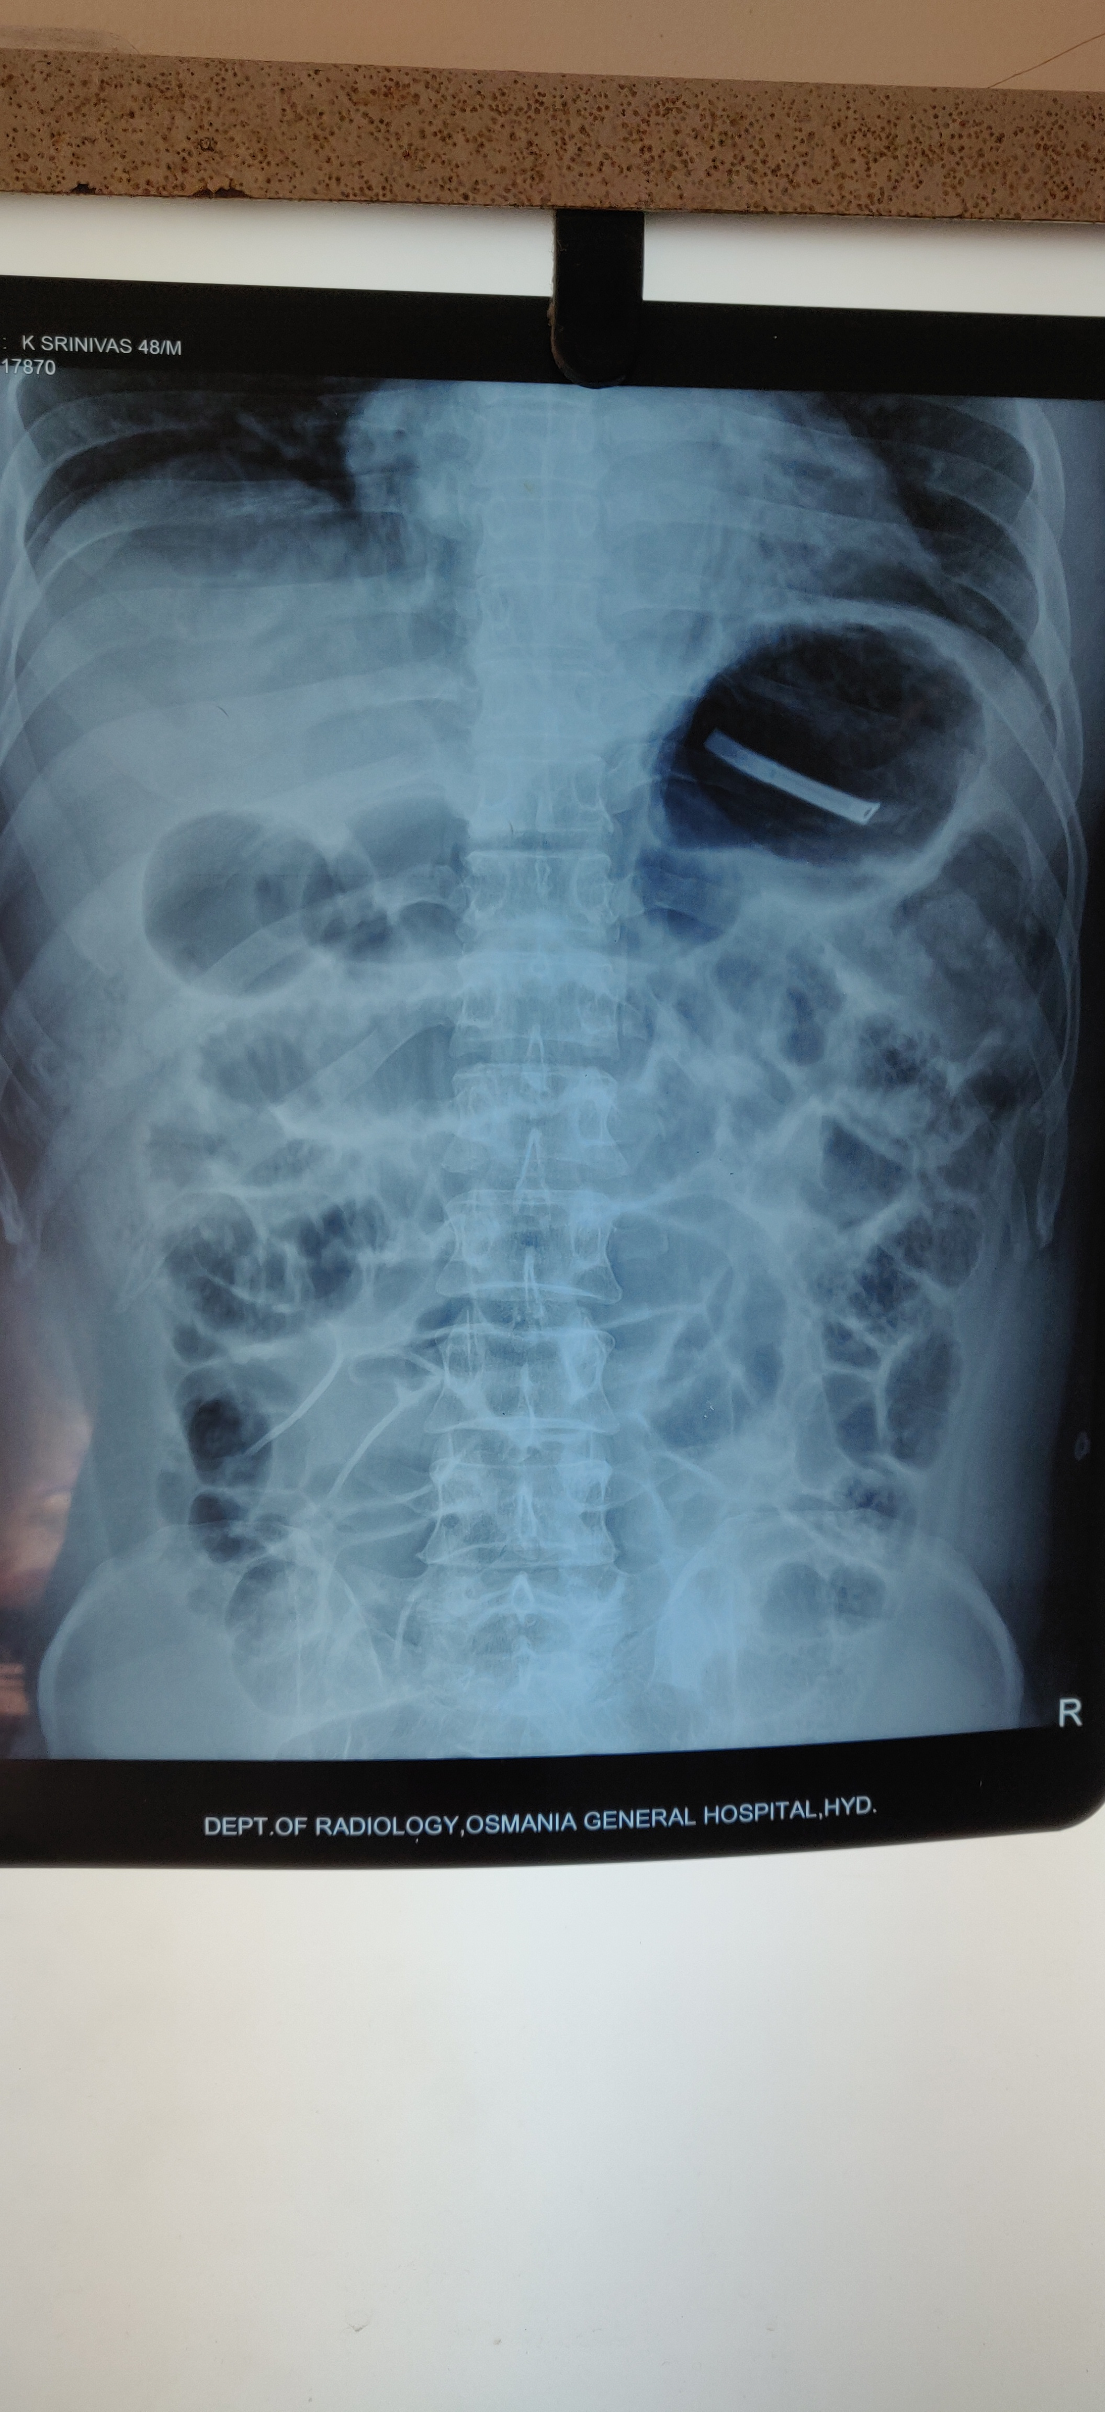
Management
An immediate rigid oesophagoscopy was performed under general anaesthesia. The scope was passed up to the gastro oesophageal junction, unfortunately the foreign body was not visualized.
A repeat X-ray chest with abdomen was performed after the recovery of the patient, which revealed the foreign body in the fundus of the stomach.

Slide 7
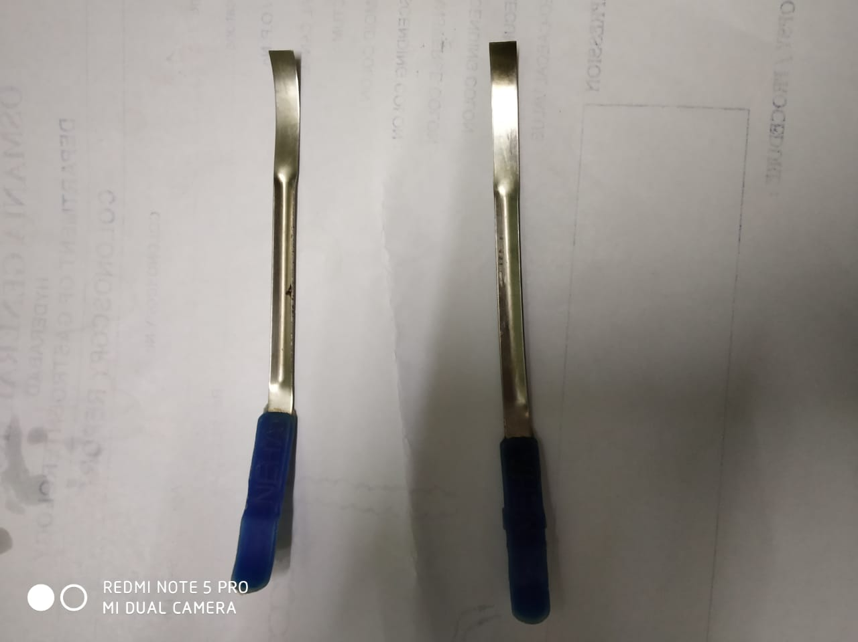
management
The patient was then referred to gastroenterolgy department, where a flexible endoscopy under sedation was performed and confirmed the x-ray findings.
The broken part of the tongue cleaner in the body of the stomach was removed by rat toothed forceps.

Slide 8
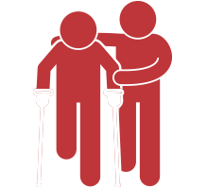
Post operative recovery
The patient recovered well and started oral feeds 6 hours post endoscopy.
He was discharged on second post operative day.

Slide 9

discussion
The vast majority of foreign bodies pass through the gastrointestinal tract uneventfully and no medical/surgical treatment is necessary. Endoscopic treatment or surgical intervention are necessary in 20% and 1% of cases, respectively .
Swallowing of FBs occurs more commonly in children, especially between the age of 6 months and 3 years, and in specific adult risk groups, such as prisoners, alcoholics, edentulous adults and psychiatric patients . Structural or functional abnormalities of the oesophagus represent the major risk factors . Our patient did not belong to any of these risk categories.
The most common types of ingested objects in the oesophagus are food-related foreign bodies, such as bones, meat bolus, nuts and seeds, or coins, pins and toys. The accidental ingestion of artificial dentures is most common in the elderly.

Slide 10

discussion
Clinically, oesophageal foreign body (OFB) ingestion may cause dysphagia, odynophagia, diffuse chest pain, sensation of chest pressure, laryngeal irritation. Respiratory signs, such as violent coughing, gagging or incomplete airways obstruction may also be present in cases of FB aspiration
The foreign body usually lies close to one of the 3 oesophageal anatomical constrictions: the cricopharyngeal ring, the aortic arch narrowing or the oesophago-gastric junction . It is also interesting to note that the FB position in the oesophagus differs with age, the lower third being the most common in adults
The FB, in our patient, was located in the lower third of oesophagus ,posing difficulty in rigid endoscopy due to its size. It is important to remember that management of OFB requires a multidisciplinary approach (gastroenterologist, radiologist, ENT specialist or even a thoracic surgeon).

Slide 11
discussion
FB in the oesophagus can cause mucosal inflammation, ulceration and perforations and, consequently, severe infections such as mediastinitis, deep neck abscess aspiration, pleural empyema may occur. Other complications reported are scarring, obstruction and fistulization .
To confirm the diagnosis of FB of the upper digestive tract, radiological assessment is necessary. Plain films (neck and chest X-rays) are a very important diagnostic tool, especially in defining the location of the FB .
CT scans can be used to confirm the presence and to study the location of FB (especially in the case of fish bones), or to evaluate any eventual damage to the neighbouring structures .

Slide 12
Discussion
In our case, chest X-rays already confirmed the presence and the localization of the FB, and, therefore, no other radiological procedure was necessary.
The treatment of choice for OFB depends on various parameters such as patient’s age, his/her clinical condition, the type, size, shape, site and also number of FBs. In fact, endoscopy is the preferred method for OFB extraction with a reported success rate of 83%.
Today, both rigid or flexible endoscopy, performed under general anaesthesia or conscious sedation, respectively, are considered to be safe and represent effective methods, in experienced hands. For the management of sharp and penetrating FB, rigid endoscopy is often the treatment of choice. Major risks during oesophagoscopical maneuvers include direct instrumental wounds and perforation.

Slide 13
Thank you
Dr. Chandana Allu
First Year Postgraduate
E.N.T

